Slide 1



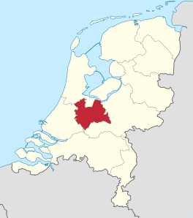

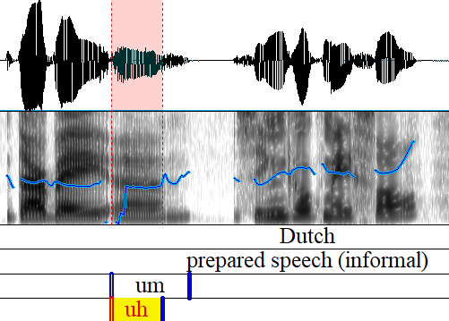


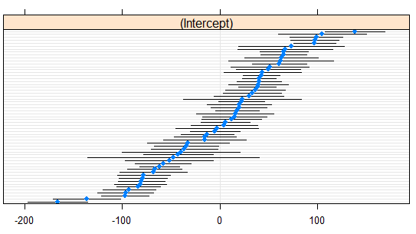
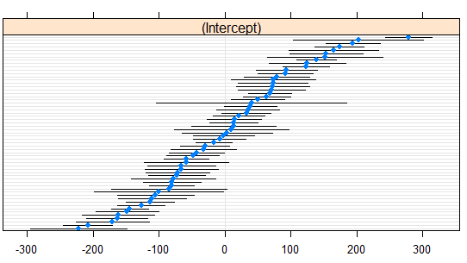
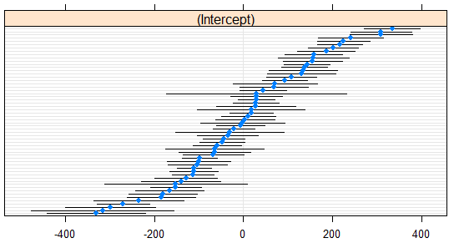



THE ROLE OF POSITION IN NATIVE AND NON-NATIVE FILLED PAUSE ACOUSTICS
Meike de Boer & Willemijn Heeren
Introduction
Materials & Methods
Results: fixed part
Filled pause acoustics depend on:
  1) The language (Clark & Fox Tree, 2002; Rose, 2013)
    uh, um eh, ehm este ano, e-to
  2) The speaker
    different between speakers (Hughes et al., 2016)
    consistent within speakers (Braun & Rosin, 2015)
  The position in the utterance
  (Braun & Rosin, 2015; De Jong, 2016; Swerts, 1998)
Do L2 speakers transfer their filled pauses from their L1?
  No, vowel realization differs between L1 Dutch and L2 English (De Boer & Heeren, 2019)
Follow-up question: Are cross-linguistic results maintained when the position in the utterance is considered?
Speakers (N = 59)
Recordings
Database of the Longitudinal Utrecht Collection of English Accents
(D-LUCEA; Orr and Quené, 2017)
Semi-spontaneous informal monologues: 2 minutes per language
Close-talking microphone (headset)
Segmentation and Measurements
Language
  Dutch
  English
Position
  start
  mid
  end
  single
Linear Mixed-Effects Models (Bates et al., 2015; R Core Team, 2017)
Reference = Dutch, single
Reference = Dutch, start
N.B. Empty cells indicate that there is no significant difference when compared to the intercept.
M =
18.4 (0.8)
Feature (in ms) | Intercept | Position |  |  | Language
 |  | start | mid | end | English
vDuration (uh) | 381 | -120 | -135 | -69
vDuration (um) | 261
Duration (um) | 506 | -84 | -68 | -52
L1
L2
age
}
speaker-
specific
Feature (in Hz) | Intercept | Position |  |  | Language
 |  | mid | end | single | English
F0 (uh) | 202 | -13 | -17 | -8
F0 (um) | 207 | -20 | -23 | -6
F1 (uh) | 657 | -24 | -36 | -28 | +26
F1 (um) | 674 | -29 | -26 |  | +35
F2 (uh) | 1,663 |  |  |  | -28
F2 (um) | 1,615 |  |  |  | -29
F3 (uh) | 2,745
F3 (um) | 2,764 | -53 | -67
Type
  uh
  um
Tokens: 2,106
  (Vowel) duration
  Fundamental frequency (F0)
  Vowel formants
  (F1, F2, F3)
raised F0
longer duration
Um, I uh would say…
more common in L2 speech
lowered F0
shorter duration
Segmentation in Praat (Boersma, 2001)
Results: random part
Conclusion
References
By-speaker slopes for Position and By-speaker intercepts Language: included in optimal model? (included in all models):
Reference = Dutch, single
Reference = Dutch, start
Position did not change the effect of Language (cf. De Boer & Heeren, 2019), nor did we observe interaction effects between Language and Position.
Although Position affected nearly all filled pause acoustics, the cross-linguistic differences in F1 and F2 values remained present.
Speakers differed from each other in their filled pause acoustics. In addition, they often differed in the extent to which their acoustics were affected by Position or Language.
Bates, D., Maechler, M., Bolker, B., & Walker, S. (2015). Fitting linear mixed-effects models using lme4. Journal of Statistical Software, 67(1), 1-48.
Boersma, P. (2001). Praat: doing phonetics by computer [computer program]. Version 6.0.37, retrieved from http://www.praat.org/
Braun, A., Rosin, A. (2015). On the speaker-specificity of hesitation markers. ICPhS, 731−736.
Clark, H.H., & Fox Tree, J.E. (2002). Using uh and um in spontaneous speaking. Cognition, 84(1), 73-111.
De Boer, M.M., & Heeren, W.F.L. (2019). The speaker-specificity of filled pauses: A cross-linguistic study. ICPhS, 607-611.
De Jong, N.H. (2016). Predicting pauses in L1 and L2 speech: The effects of utterance boundaries and word frequency. International Review of Applied Linguistics in Language Teaching, 54(2), 113-132.
Hughes, V., Wood, S., & Foulkes, P. (2016). Strength of forensic voice comparison evidence from the acoustics of filled pauses. Journal of Speech, Language and the Law, 23(1), 99-132.
Orr, R., & Quené, H. (2017). D-LUCEA: Curation of the UCU Accent Project data. CLARIN in the Low Countries, 177-190.
R Core Team (2017). R: A language and environment for statistical computing. R Foundation for Statistical
Computing, Vienna, Austria. Retrieved from http://www.R-project.org/
Rose, R.L. (2013). Crosslinguistic corpus of hesitation phenomena: A corpus for investigating first and second language speech performance. Interspeech, 992-996.
Swerts, M. (1998). Filled pauses as markers of discourse structure. Journal of Pragmatics, 30(4), 485-496.
Feature (in ms) | Position | Language
vDuration (uh) | no | no
vDuration (um) | yes | yes
Duration (um) | no | no
F1
um
Feature (in Hz) | Position | Language
F0 (uh) | yes | no
F0 (um) | yes | yes
F1 (uh) | no | yes
F1 (um) | no | no
F2 (uh) | no | no
F2 (um) | yes | yes
F3 (uh) | no | no
F3 (um) | no | no
F2
Back to the original question
Acknowledgements
um
Native speakers of Dutch shift the vowel formants (F1, F2) of their filled pauses when speaking in L2 English:
    They increase their F1 to a more open vowel
    They decrease their F2 to a more back vowel
For more information, please contact m.m.de.boer@hum.leidenuniv.nl
This research was supported by a VIDI grant from The Netherlands Organisation for Scientific Research (NWO). Thanks to T. Haga, J. van der Graaf, and Y. Sleeboom for their help in the annotations.
F3
um

